Slide 1
English Tour Guiding Interpretation on Erkan Village
Lillian
Julia
Michael
Nicole
Supervisor : Chris Hung

Slide 2
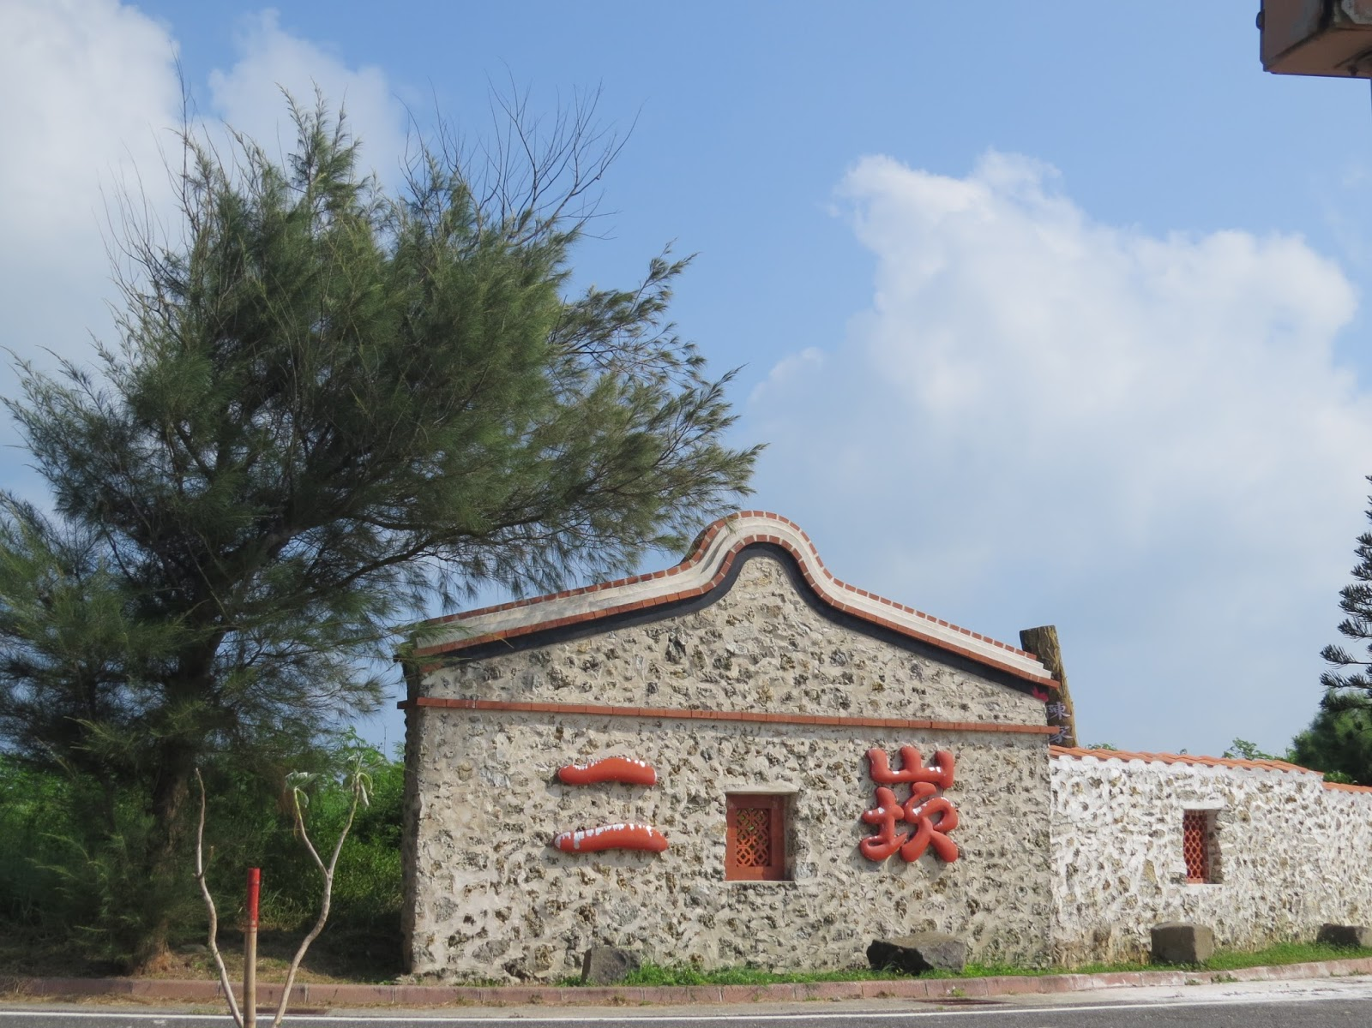
English Tour Guiding Interpretation on Erkan Village

Slide 3
Outlines of Presentation
01
Introduction
02
Literature review
03
Methodology
04
Results
05
Conclusion
06
Video showing

Slide 4
Introduction
Employ what has learned at school
Provideing English tour interpretation to international visitors on cultural aspects
Improving English communication and interpretation skills
Investigate the quality and problems during the interpretation
Purpose

Slide 5
Literature Review
01
Tourism as a Backbone of Economy
Penghu Tourism Development
Cultural Tourism
Media in Tourism
02
03
04

Slide 6
Tourism as a backbone of economy
Chart 1 Top 8 Countries – Travel &Tourism GDP Growth, 2018

Slide 7
Tourism as a backbone of economy
As a engine
of economic
As a vehicle for sharing cultures
Sharing cultures
Building mutual understanding

Slide 8
Penghu tourism development
Chart 3 Ratio of Employment to Employment in Various Industries in Penghu County

Slide 9
Chart 4 Statistics on the Number of Tourists in Penghu in May 2017 and May 2018
drop
Chart 5 Statistics on the Number of Tourists in Penghu in August 2017 and August 2018

Slide 10
Cultural Tourism
Learn
Explore
Experience
Tangible
Consumption
Intangible
Cultural Tourism

Slide 11
Cultural Tourism
Table 1 Estimates of International Cultural Tourism Arrivals
Note:
Narrow definition : Movements of persons for cultural motivations including study tours, preforming arts and cultural tours, etc.
Broad definition : All movements of persons tend to raise the cultural level of the individual and giving rise to new knowledge, experience and encounter.

Slide 12
World's most visited websites
Table 2 World’s most visited websites in 2018
Website | Category | Time per visit
Google.com | Search | 09M 12S
YouTube.com | Video | 21M 36S
Facebook.com | Social | 11M 44S
Baidu.com | Search | 06M 53S
Wikipedia.org | Reference | 03M 45S
Yahoo.com | Portal | 06M 26S
Twitter.com | Social | 09M 14S
Yandex.ru | Search | 10M 43S
Instagram.com | Social | 06M 25S
Amazon.com | Shopping | 06M 18S
1
2

Slide 13
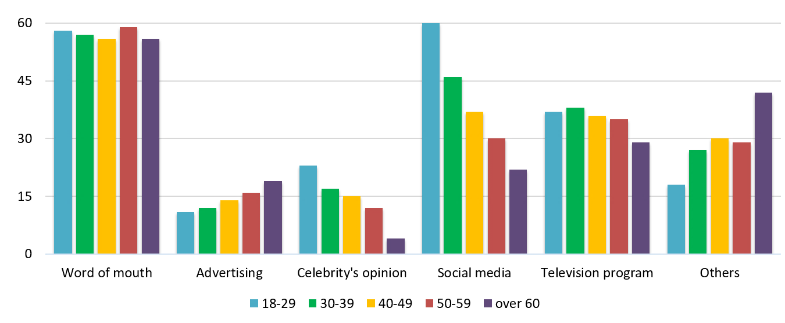
Distribution of Travel Inspiration Sources for Different Ages
Chart 10 Distribution of Travel Inspiration Sources for Different Ages

Slide 14
Methodology

Slide 15
Participants
International visitors travel to Penghu
Location
Erkan village in Xi-Yu Country
The first traditional settlement preservation area in Taiwan

Slide 16
Instruments
Video making
Questionnaire – Google sheets
Reservation form
Satisfaction feedback form
Action Research Methodology
In solution of practical problems
Five places, four videos

Slide 17
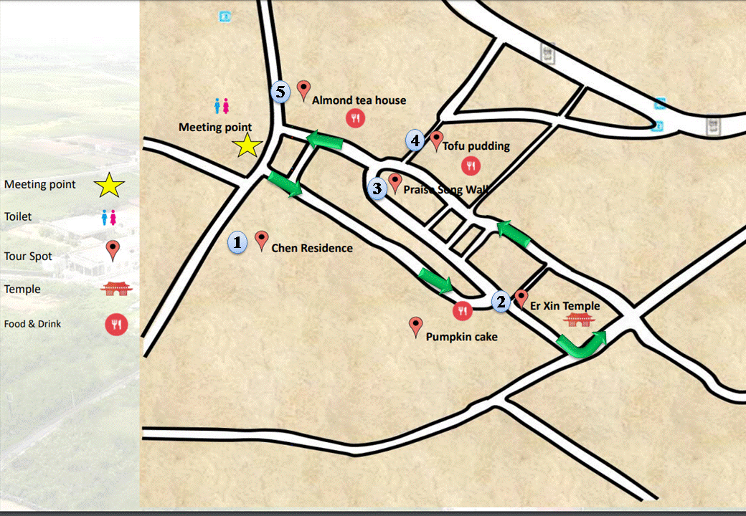
Routes: five major stops
Figure 3 Routes and Places of Erkan Tour Interpretation

Slide 18
Timeline
Table 3 Timeline of Tour Guiding Interpretation in Erkan interpretation in Erkan

Slide 19
Results and Discussion

Slide 20
Results and Discussion
Collecting the Text Reference and Preparing the Scripts for Interpretation
Reinforcement on Interpretation Skills
Problems in Tour Guiding and Interpretation
Demographic Profile and Feedback Questionnaire
4-1
4-2
4-4
4-3

Slide 21
Tilden’s six principles
Personality and experience
Based on information
An art
Not instruction, but provocation
Presents a whole
Different audience

Slide 22
Collecting the Text Reference and Preparing the Scripts for Interpretation
Table 5 Contrast of Factual Data with Modified Interpretation on Chen’s Residence
Chen’s residence | Sample of factual data | Words and phrases with underlined are interpreted messages beyond the factual message.
The eagle | The eagle represents the owner of the house, and hope that future generations will be a success | The eagle represents the owner. The eagle symbolizes the ferocity and supremacy, preaching the power of the family-like an eagle, and hopes that future generations will be a success.
The lamp urn | 燈甕, the lamp urn. | In Taiwanese, 燈甕the lamp pronounced as丁旺 (din-won). The Chinese word 丁din means man force, and 旺 won means prosperity. Therefore, lamp urn has the meaning of having a long line of future generations.

Slide 23
Table 5 Contrast of Factual Data with Modified Interpretation on Chen’s Residence
The fish | Fish means have something left every year | Fish means to have something left every year, 魚(fish) pronounced as YU, which is the same pronunciation as餘(surplus) YU.年年有魚(餘), is the auspicious phrase often mentioned in the Chinese New Year Eve hoping there will be a surplus, that is to have something left every year.
The pumpkin | Pumpkins mean many children and grandchildren | Pumpkins mean many children and grandchildren because there are lots of seeds in the pumpkin. In Chinese, we say 多子多孫 ( many sons and many grandsons) means t have a long line of offspring.
The clock | This word in Chinese is鐘, it can be disassembled into 金and 童, meaning golden boys and beautiful girls. | This word 鐘in Chinese can be disassembled into 金 (Jing) and 童 (Tong), meaning golden and boys. In Chinese, 金童玉女meaning Golden boys and beautiful girls. Therefore, the clock symbolized as hoping to have great generations.

Slide 24
Reinforcement on Interpretation Skills
Learning from the interpretation videos
TORE skills by professor Sam H. Ham
B. Practicing pronunciation
Cultivation of English mindset
Not direct translating from Chinese sentences
D. In class simulation training
E. Dual practice

Slide 25
Problems in Tour Guiding and Interpretation
Spontaneous interpretation ability
Unfamiliarity of ancient objects
Unexpected accidents
Language problems
Directorial signal

Slide 26
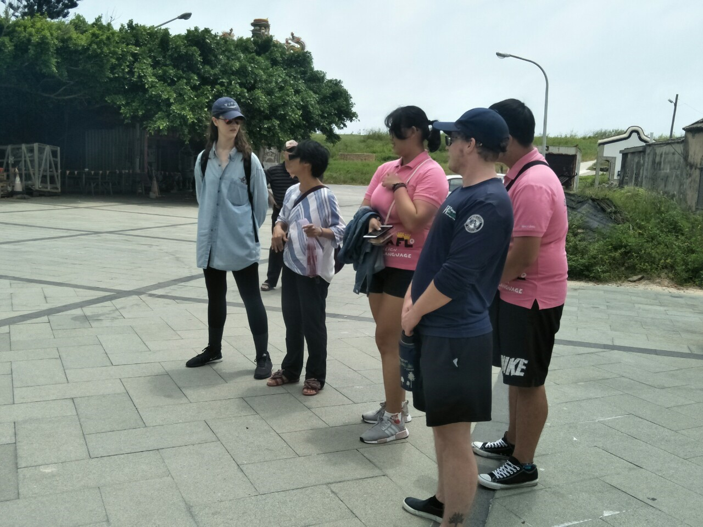
Spontaneous interpretation ability

Slide 27
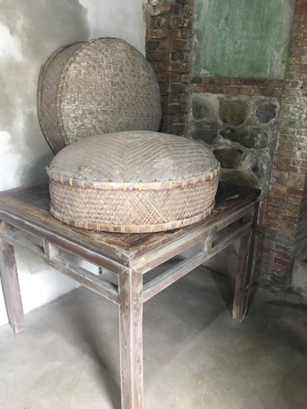
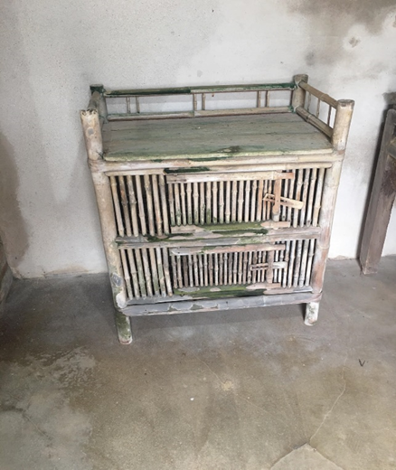
Unfamiliarity of ancient objects

Slide 28
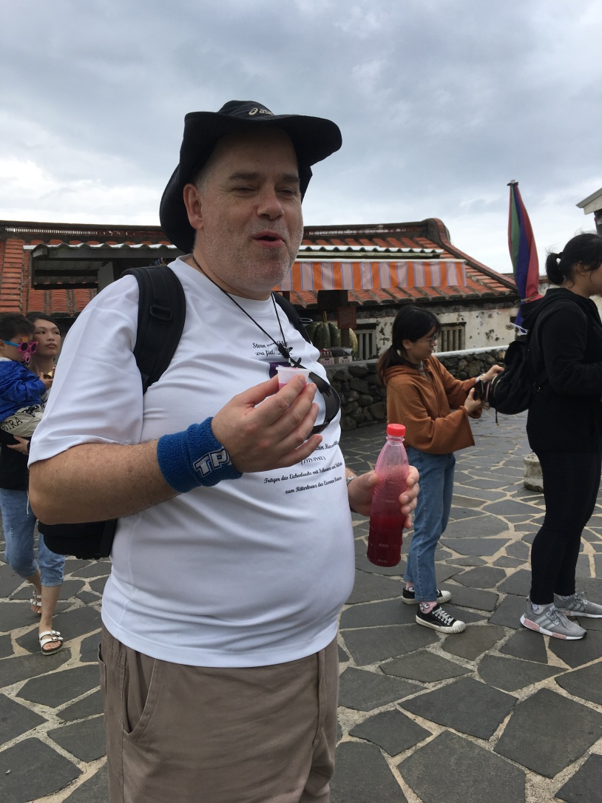
Unexpected accidents

Slide 29
Language problems and body language
仄之安
The hands are struggling to express something

Slide 30
Directorial signal

Slide 31
Demographic profile of the international visitors

Slide 32
Feedback Questionnaire (section one)

Slide 33
Feedback Questionnaire (section two)

Slide 34
Feedback Questionnaire (section three)

Slide 35
Feedback Questionnaire (section four)

Slide 36
Preferences on Contents of Tour Guiding
The foreigner visitors took a lot of interests in knowing the symbolic meanings.
Some visitors complained about the renovation of Er-Xin Temple is too modern.
The praise songs on the wall interests the visitors as the poetry is chanted in Taiwanese.

Slide 37
Conclusion
The limitation of the study
Few numbers of international visitors.
Future Studies
Understand the preference of international visitors.

Slide 38
“Nothing ever becomes real till it is experienced.”
John Keats
Wisdom
Experience
Knowledge
Information
Data
Retrieved from : https://www.researchgate.net/figure/Interrelations-among-
data-information-knowledge-experience-and-wisdom_fig1_319391419

Slide 39
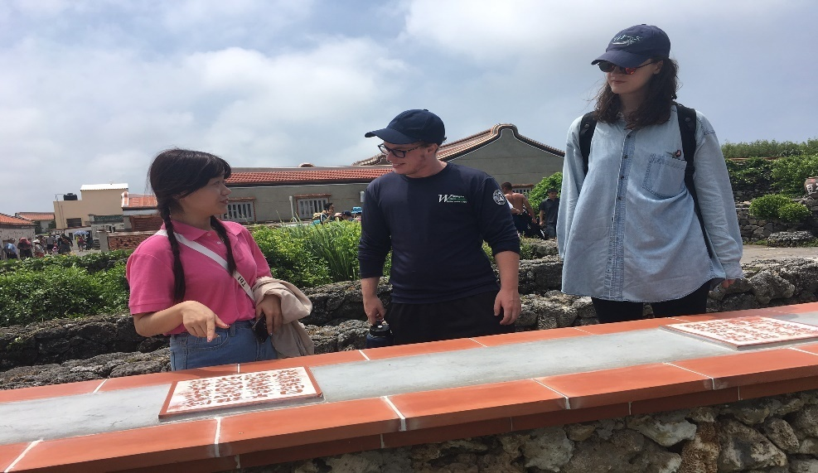
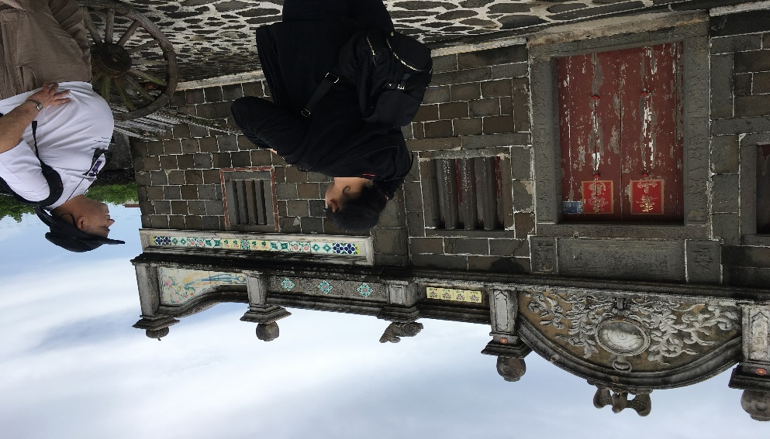
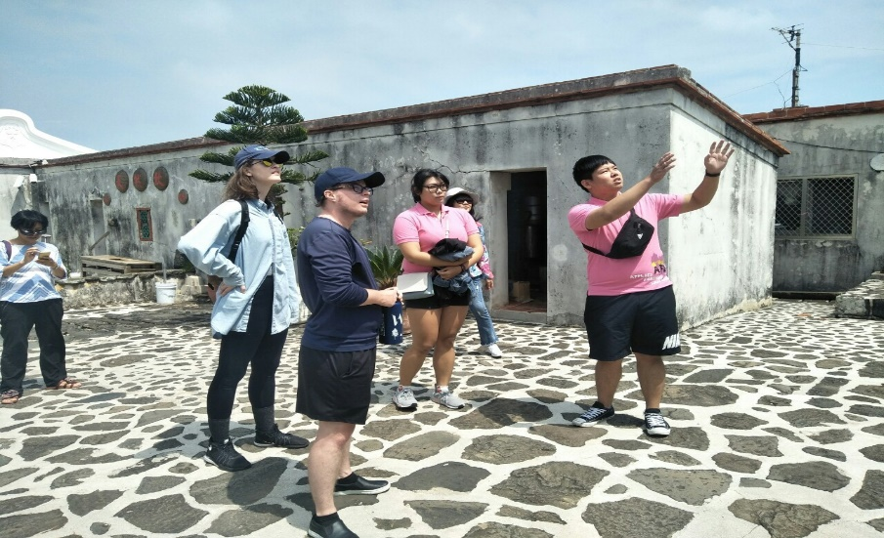
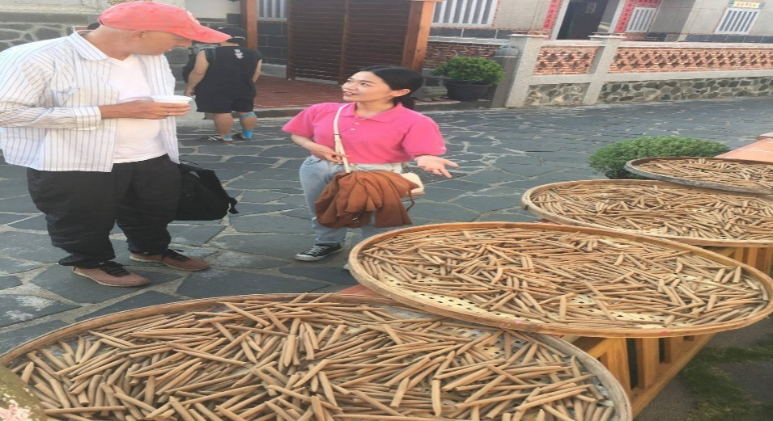
Video showing

Slide 40
Video showing

