Slide 1
A Comparative Study on English Dialogues from Second Language Learners' Perspective:
English Textbooks in Taiwan vs. American Situation Comedies
method
Name:
TING TING LIN (Tina Lin) 1104402035
WEN TING XIE (Tina Xie) 1104402003
YAN HUA CHEN (Chelsea) 1104402018
KUN WANG (Noah) 1104402021
RUI BO WANG (James) 1104402022
ZHEN LONG LIN (Heath) 1104402023
TSAI NI KAO (Doris) 1104402045
Advisor: CHIA HUNG LIN (Max)
conclude
compr 3
compr 2
compare
intro

Slide 2
Background
Students’ low motivation to learn English
Overburden & limitation - exams
conclude
compr 2
method
compr 3
compare
intro

Slide 3
Purpose of Study
Searching for more intriguing English materials
Increasing learners’ motivation
Expanding students’ vocabulary and sharpening their listening skill
conclude
compr 2
method
compr 3
compare
intro

Slide 4
Textbook Touchstone V.S Sitcom Friends
Friends
An American situation comedy
Popular around the world for decades
Touchstone
Published by prestigious Cambridge Univ. Press
A major English textbook adopted at universities in Taiwan
conclude
compr 2
method
compr 3
compare
intro

Slide 5
Research Framework
Observing students’ responses toward Touchstone (English textbook) and Friends (Sitcom) via interviews
conclude
method
compr 3
compr 2
compare
intro

Slide 6
Textbook
Research Steps
Let the students read a paragraph, and then ask them what it is about.
conclude
method
compr 3
compr 2
compare
intro
Give the students a test.
Let the students read the paragraph by themselves, and then after the audio CD.

Slide 7
Sitcom
Research Steps
Show them a short film without sound, guessing what happens.
Give students the same test.
conclude
method
compr 3
compr 2
compare
intro
Turn the volume on, and ask them to mark the part where canned laughter appears.
Let students choose a line and imitate the actor/actress’s reactions.

Slide 8
Research Result
Getting rough ideas: Textbook ≒ Sitcom
Reading test result: Textbook < Sitcom
conclude
method
compr 3
compr 2
compare
intro

Slide 9
Sitcom
audio-visual explanations of English words
vivid examples of conversation (with tones, facial expressions, and body language), further demonstrating delicate details of English
expressions in various situations for learners to grasp ways of language application
conclude
method
compr 3
compr 2
compare
intro

Slide 10
conclude
method
compr 3
compr 2
compare
intro
1
2
3
Learning Efficiency
Application
Values

Slide 11
Learning Efficiency
English Textbook (Touchstone):
Grammatical correlation between the contents of each unit
conclude
method
compr 3
compr 2
compare
intro
American Sitcom (Friends):
Dramatic correlation between each episode

Slide 12
Application
English Textbook (Touchstone):
Characters: weak
Conversations: monotonous and inauthentic
Description of culture: superficial
Topics: Not quite popular
conclude
method
compr 3
compr 2
Compare
intro
American Sitcom (Friends):
Characters: lively
Conversations: diverse and authentic
Description of culture: vivid
Topics: popular

Slide 13
Values
English Textbook (Touchstone):
Focusing on knowledge input rather than cultivation of reflection
conclude
method
compr 3
compr 2
Compare
intro
American Sitcom (Friends):
Disclosing varied perspectives

Slide 14
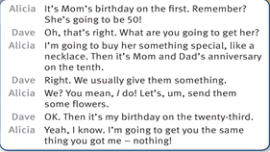
In Touchstone
Formal and Informal
Advantage
Sentences strictly follow grammar rules to help students learn.
Disadvantage
conclude
method
compr 3
Compr 2
compare
intro
Students barely learn colloquial speech from the textbook.

Slide 15
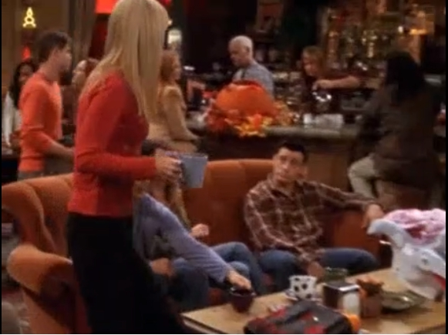
In Friends
Formal and Informal
Advantage
Disadvantage
Colorful and engaging conversations
Vulgar and bawdy words not censored
conclude
method
compr 3
Compr 2
compare
intro
Phoebe: Oh hey you guys, I couldn‘t get a reservation for the night of my birthday, so we have to do dinner Thursday night instead.(美國口語)
Joey: Thursday? But that's Halloween.
Phoebe: So?
Joey: So spooky, that's all.
Ross: So, so, is Mike coming to dinner?
Phoebe: No! It‘s my first birthday with a boyfriend, and he has to work. Ugh, I get mad at him, but I think it’s a little too soon to show my true colors.(口語，語助詞)

Slide 16
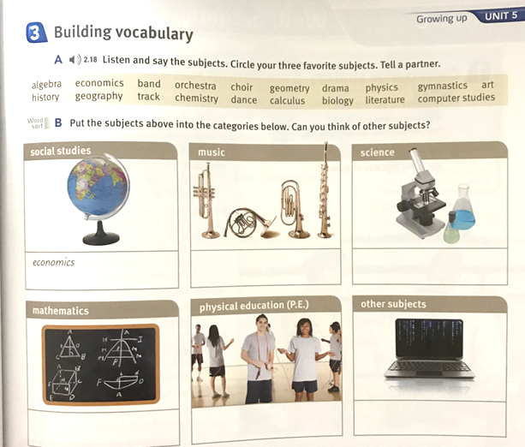
In Touchstone
Vocabulary Learning Effect
Advantage
Its exercises help students memorize vocabulary.
conclude
method
compr 3
Compr 2
Disadvantage
compare
intro
Too many exercises may overburden students.

Slide 17
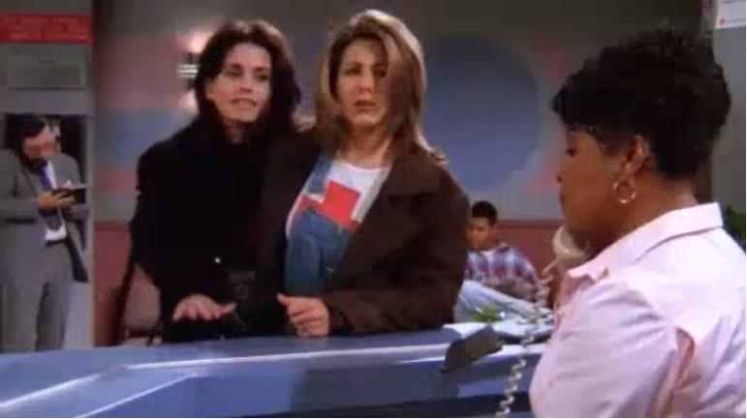
In Friends
Vocabulary Learning Effect
Advantage
Disadvantage
Its characters’ expressions and interactions demonstrate the usage of vocabulary.
Words could be too colloquial or informal to be grasped by learners quickly.
conclude
method
compr 3
Compr 2
compare
intro
Monica: Hi. Uh, my friend here was taking down our Christmas lights, and and she fell off the balcony and may have broken her foot or or ankle or something.
Nurse: My God. You still have your Christmas lights up?
Nurse: Fill this out and bring it back to me.
Monica: Okay, ooh, alright. Name, address... Are you currently on any medication? (與一般正式用法 take medicines 一樣的意思)
Rachel: No, oh, wait. Yes, Blistex.(一種醫用潤唇膏)

Slide 18
In Touchstone
Learning Concentration
Advantage
systematic and well-organized for students
conclude
method
compr 3
Compr 2
compare
intro
Disadvantage
Monotonous, not enticing students to learn

Slide 19
In Friends
Learning Concentration
Advantage
Disadvantage
The humorous conversations increase students’ motivation to learn.
Staring at the screen for a long time could cause poor eyesight.
conclude
method
compr 3
Compr 2
compare
intro
Woman: It's okay, it's okay, I'm here, and I’m here. Sorry I'm late, okay, here I am. Who's the new tense girl?
Teacher: She's your partner.
Woman: Hi. I'm Monica.
Monica: Oh. Monica! ...Hi. I‘m Mo- ...nana.(她在舞蹈课上捉到了盜用她信用卡的“假莫妮卡。)
Woman: (Fake Monica) Montana?
Monica: Yeah. It's Dutch.

Slide 20
HUMOR (Touchstone)
conclude
compr 3
method
compr 2
compare
intro

Slide 21
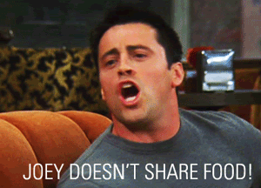
HUMOR (Friends)
conclude
compr 3
method
compr 2
compare
intro

Slide 22
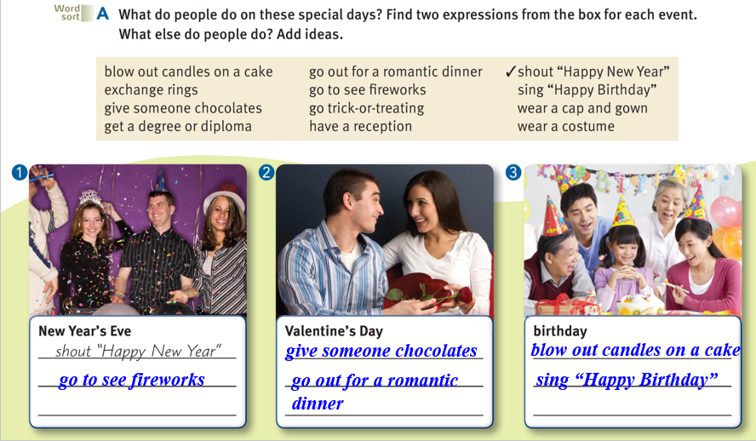
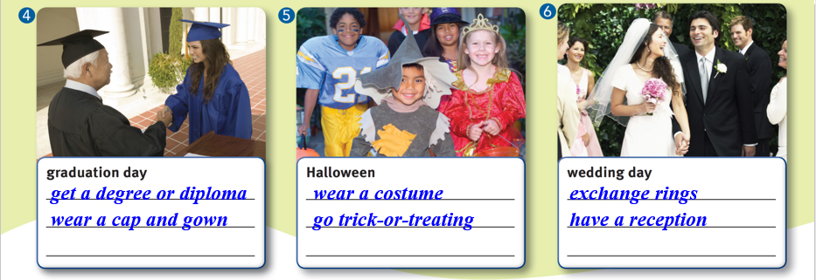
CULTURE (Touchstone)
conclude
compr 3
method
compr 2
compare
intro

Slide 23
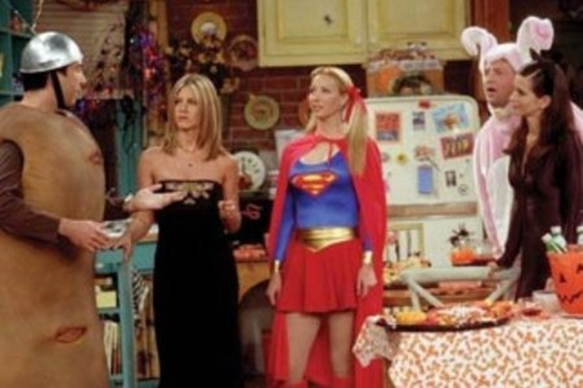
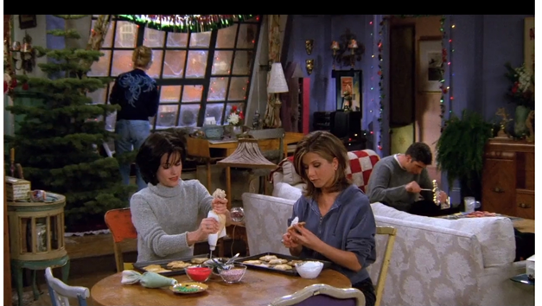
CULTURE (Friends)
Halloween
conclude
compr 3
method
compr 2
compare
intro
Thanksgiving
Christmas

Slide 24
Conclusion
method
conclude
compr 3
compr 2
compare
intro

Slide 25
TEXTBOOK
inflexible
conclude
method
compr 3
compr 2
compare
intro
theoretical

Slide 26
SITCOM
versatile
conclude
method
compr 3
compr 2
compare
intro
down-to-earth

Slide 27
TEXTBOOK | SITCOM
Organization | Attraction
Explanation | Demonstration
conclude
method
compr 3
compr 2
compare
intro

Slide 28
Sitcom
Textbook
1
2
intriguing
teaching
conclude
method
compr 3
compr 2
compare
intro

Slide 29
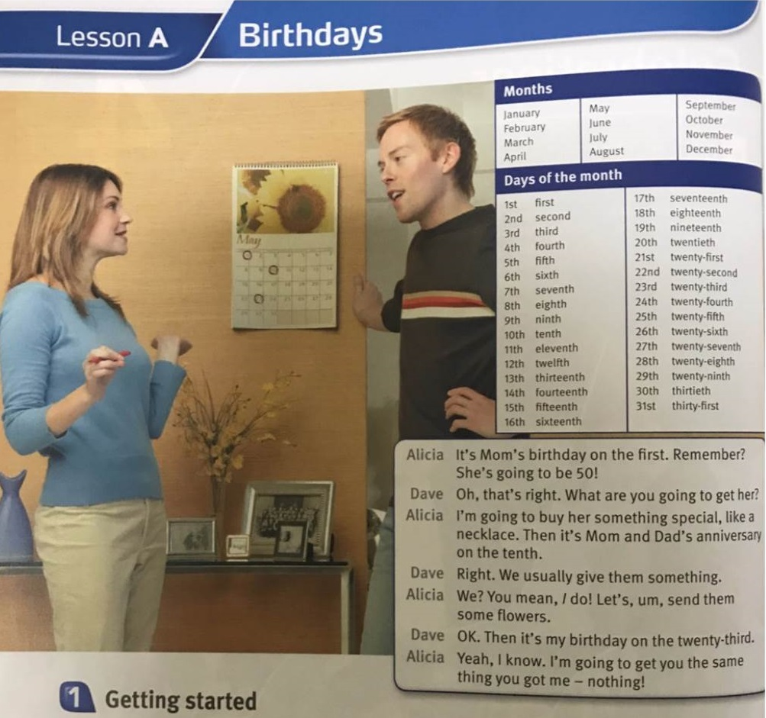
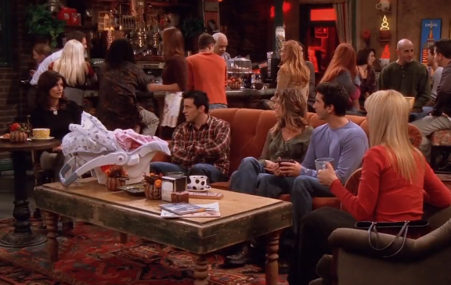
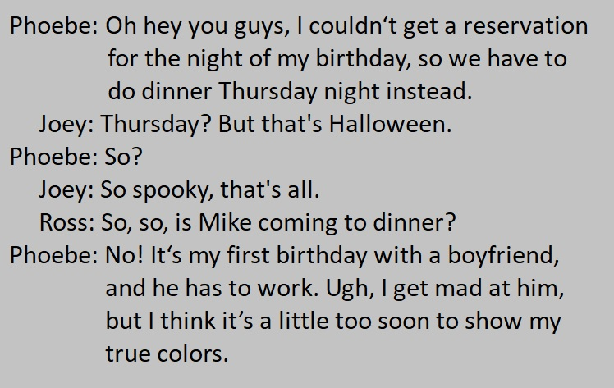
Suggestion
conclude
method
compr 3
compr 2
compare
intro

Slide 30
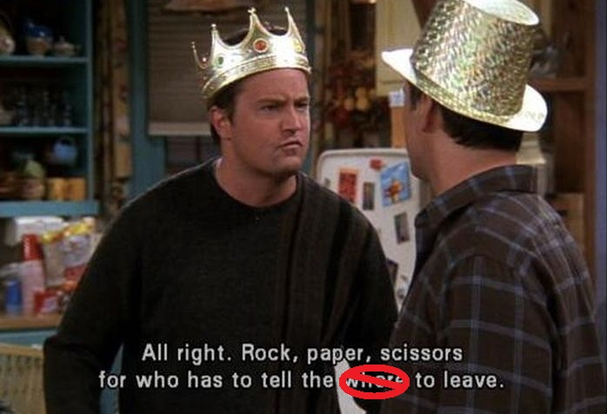
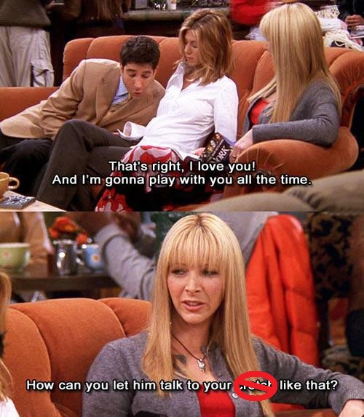
Suggestion
Some inappropriate contents
conclude
method
compr 3
compr 2
compare
intro

Slide 31
Thanks
for
conclude
method
compr 3
compr 2
compare
intro
listening.

