Slide 1
The Impact of English Proficiency on the Tourism Industry of Taiwan
Chapter One
Teacher ：Chris Hung
Members：
Jocelyn
Jerry
Shirley
Vicky
Introduction
Daniel
Kyle
Lisa

Slide 2
Motivation
Under the booming tourism industry, the tourism industry has become a huge industry affecting the entire national economy

Slide 3
Background
English ability is an indispensable ability in tourism, and English is a common language in the world

Slide 4
The purpose of the study
Exploring self-awareness of the English proficiency of the people engaged in the tour business
Understanding if English proficiency affect consumer’s choices of visitors to Taiwan

Slide 5
The Impact of English Proficiency on the Tourism Industry of Taiwan
Chapter Two
Teacher ：Chris Hung
Members：
Jocelyn
Jerry
Shirley
Vicky
Literature Review
Daniel
Kyle
Lisa

Slide 6
Literature Review
The 20th century tourism industry
Successfully attracting foreigner
Increase foreign exchange income
Improve people's quality of life

Slide 7
Global Tourism Competitiveness
Tourism resources
Quality of service personnel
The World Economic Forum
Safety
Health
Transportation convenience

Slide 8
210987654321098765432109876543210
0987654321098765432109876543210
7654321098765432109876543210
321098765432109876543210
321098765432109876543210
098765432109876543210
Global tourism competiveness ranking
2016
2017
2017
In countries around the world
In countries around the world
In Asian countries
th
th
th

Slide 9
3
2
Tourism services
Complete in infrastructure
Perfect sanitary conditions
Notes:
The 2017 report shows that despite the threat of terrorism, Europe has a wealth of cultural resources, comprehensive tourism services, complete in infrastructure, hygienic conditions and international standards. The top three in Spain, France and Germany remain unchanged.

Slide 10
Taiwan Tourism Income
14.388
12.315
16.8%
Notes:
Taiwan’s foreign exchange income
In 2015, there were 1.438 billion US dollars
There were $1.2315 billion in 2017
Reduced $207.3 million in 2 years
A total reduction of 16.8%

Slide 11
Foreigners coming to Taiwan for sightseeing
299,816
10,739,601
10,439,785
Notes:
Foreigners coming to Taiwan
In 2015，There were 10,439,785 people.
In 2017，There were 10,739,601 people.
In 2 years, an increase of 299,816 people
And data from the US and Canada can be found

Slide 12
Americans coming to Taiwan
Canadians coming to Taiwan
542,261
143,691
428,650
34.2%
20.9%
94,531
Notes:
Americans come to Taiwan
There were 428,650 people in 2010.
There were 542,261 people in 2016.
Growing 20.9%
Canadians come to Taiwan
There were 94,531 people in 2010.
There were 143,691 people in 2016.
Growing 34.2%

Slide 13
The Impact of English Proficiency on the Tourism Industry of Taiwan
Chapter Three
Teacher ：Chris Hung
Members：
Jocelyn
Jerry
Shirley
Vicky
Research method
Daniel
Kyle
Lisa

Slide 14
Research method
①
From 2018/07/01
Using google sheet
③
Distributed online
④
Deadline 2018/10/30
Notes:
As university students in Taiwan, we were motivated to take part in the international affairs by participating international services, either in internship or volunteering, because we want to take on new Challenges to improve language skills to open up our Horizons, to seize the Opportunity offered by school.

Slide 15
Copies of Questionnaires
Chinese Questionnaire
English Questionnaire
Number of copies:345
Number of copies:104
Total of copies:449

Slide 16
Speaking
Listening
Personal Background
Communication in English

Slide 17
The Impact of English Proficiency on the Tourism Industry of Taiwan
Chapter Four
Teacher ：Chris Hung
Members：
Jocelyn
Jerry
Shirley
Vicky
Results and Discussion
Daniel
Kyle
Lisa

Slide 18
Twenty to thirty years old
Notes:
The age group ranged from 20-30 is the greatest in two questionnaires.

Slide 19
56.8%
43.2%
Female
respondents
Male
respondents
Notes:
Chinese questionnaire shows female respondents outnumbered male ones.

Slide 20
70.8% people have good English proficiency
Notes:
It shows 70.8% of shop owner hire employees with good English proficiency. They think language ability has positive effect on customer’s choice.

Slide 21
English certificates
01
Taiwanese with English license
51.9%
Taiwanese with English license
51.9%
02
03
04
Notes:
And 51.9% of Taiwanese have acquired English certificates and agreed certificates help with communication. They hope to improve their English proficiency to communicate with foreign customers fluently.

Slide 22
Communication
Oral practice
Familiar with accents
Notes:
Lack of oral practice and unfamiliar with foreigners’ accents are the two problems in communication.

Slide 23
54.4%
45.6%
Male
respondents
Female
respondents
Notes:
English questionnaire shows male respondents outnumbered female ones

Slide 24
English is first language
Notes:
Most respondents are from countries where English as first language

Slide 25
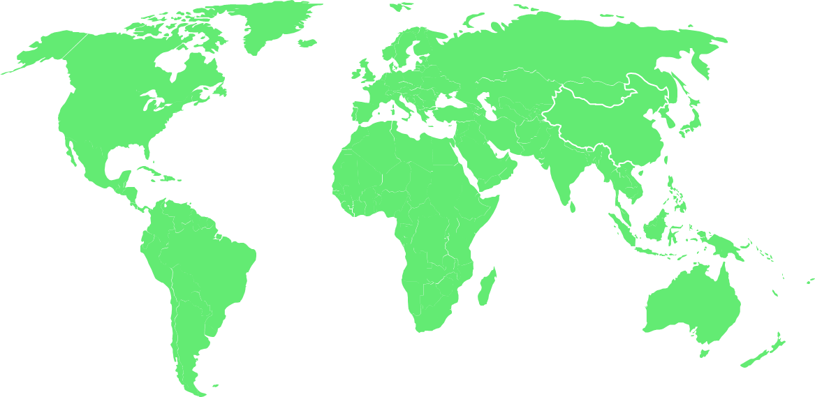
80 respondents had been to Taiwan
Working
leisure
Notes:
Eighty out one hundred three respondents have been to Taiwan, mainly for leisure or work.

Slide 26
Foreigner vs Taiwanese
You must go straight
for ten minutes，and…
54.8%
Where is
the Taipei 101?
68.9%
Notes:
54.8% of them need help from the local people when travel in Taiwan, and 68.9% of Taiwanese respond to their questions.

Slide 27
90.3%
Better English
Notes:
90.3% agree with better English ability in communication increases their willingness to visit and recommend visitors to Taiwan, but English proficiency is not a main factor to affect their willingness to visit to Taiwan.
Most visitors came to Taiwan for leisure, as Taiwan is a friendly, beautiful and safe country.

Slide 28
The Impact of English Proficiency on the Tourism Industry of Taiwan
Chapter Five
Teacher ：Chris Hung
Members：
Jocelyn
Jerry
Shirley
Vicky
Conclusion and Suggestions
Daniel
Kyle
Lisa

Slide 29
THANK YOU！

