Slide 1
Utilizing social media to engage students to in an ESP learning program
組員 : 邱 平 1102402002
邱星豪 1102402003
周香綺 1102402006
李玉泰 1102402007
陳育瑩 1102402010
王育慈 1102402023
呂之怡 1102402044
指導老師 : 譚峻濱 老師

Slide 2
Introduction

Slide 3
Research background
With time passing, the number of social media users on Facebook, YouTube, Twitter, and Weibo continues to increase.
The functions of these social media also continue to progress and become more convenient and practical.

Slide 4
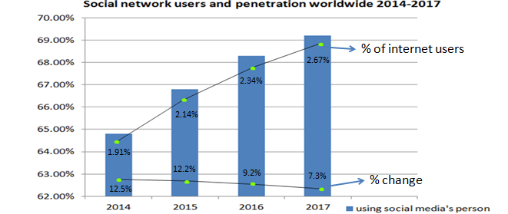
According to eMarketer’s Research, there were 16.1 billion people using social media at least once a month in 2013. And eMarketer estimates that social media users will reach 23.3 billion in 2017.

Slide 5
Purpose of study
We make suggestions for the integration of social media into the teaching of college instructors to improve the effectiveness of teaching and learning as well as enhance learning motivation and attitude.
Three research objectives
Whether the integration of social media into teaching can improve
student’s learning motivation.
interaction between students and teachers.
learning efficiency.

Slide 6
Literature Review

Slide 7
Theoretical Basis：Triadic Reciprocal Determinism
Human beings' learning behaviors are a triangular structure which is formed by three factors: personal factors, behavioral factors and environmental factors.
Personal
Factors
Behavioral
Factors
Environmental
Factors

Slide 8
Difference of Culture
The individual psychological factors, including how a person builds interpersonal relationship between self and the public, may affect the interaction between the individual and society subconsciously (Cross, Hardin, & Gercek-Swing, 2010).

Slide 9
Independent and Interdependent
The definition of the conception of self-construal that frequency of contact with individuals and groups would use different forms to display a person’s thoughts, feelings and behavioral responses. (Markus & Kitayama, 1991; Singelis,1994).

Slide 10
ESP learner’s Interactivity
Through sharing and creating information, people maintain and establish interpersonal relationships with each other (Kietzmann, Hermkens, McCarthy, &Silvestre, 2011).
The interactivity of social media is the most important thing when it was designed (Ariel & Avidar, 2015; Jiang, Chan, Tan, &Chua, 2010).
The viewpoint based on cognition because it helped take in consideration community features when studying in ESP learners’ viewpoints. Combined with previous studies, this paper defines interactivity as the extent which a learner can control information changes and connect with others.

Slide 11
Using social media to help foreign language learners
Using English E-learning websites
Performance expectations
Effort expectancy
Social influence
They will effects on behavior intentions and facilitating conditions to Taiwanese college students.

Slide 12
Advantages of utilizing technology to help learning
In a foreign language learning class, structured web –based discussion is beneficial both to students’ language production and their application of cognitive skills (Chang 2013).
Students learning within a web-based environment with self-regulated learning strategies became more responsible for their own learning, more intrinsically orientated and more challengeable (Chang 2005).

Slide 13
Research model and hypotheses

Slide 14
Research model

Slide 15
H1
H2
H3
H4

Slide 16
H5
H6
H7

Slide 17
H8
H9

Slide 18
Result

Slide 19
Measures
In order to support the thesis of this study, a questionnaire survey was done to verify our hypotheses. We use online and paper questionnaires to conduct the survey in the meantime so as to increase the validity.
After collecting these data, this study applies IMB SPSS Statistics 22 and AMOS 21 to do data analysis.

Slide 20
Table 1
Demographic information (N= 494)
Variable | Category | Numbers | Percentage
Gender | Male | 236 | 47.8%
 | Female | 258 | 52.2%
Age | <20 | 121 | 24.5%
 | 21~30 31~40 41~50 | 363 7 3 | 73.5% 1.4% 0.6%
 | >51 | 0 | 0%
Education | Elementary school or to learn to read | 0 | 0%
 | Junior high school | 5 | 1%
 | Senior high school | 67 | 13.6%
 | University of science and technology | 399 | 80.8%
 | Graduate school or above | 23 | 4.7%
Occupation | Student | 453 | 91.7%
 | Service industry | 17 | 3.4%
 | Shipping or air transport industry | 3 | 0.6%
 | Civil service | 6 | 1.2%
 | Retire | 1 | 0.2%
 | Others | 14 | 2.8%
Location | Northern part | 120 | 24.3%
 | Middle part | 63 | 12.8%
 | Southern part | 94 | 19%
 | Eastern part | 30 | 6.1%
 | Outlying islands | 184 | 37.2%
 | Others | 3 | 0.6%

Slide 21
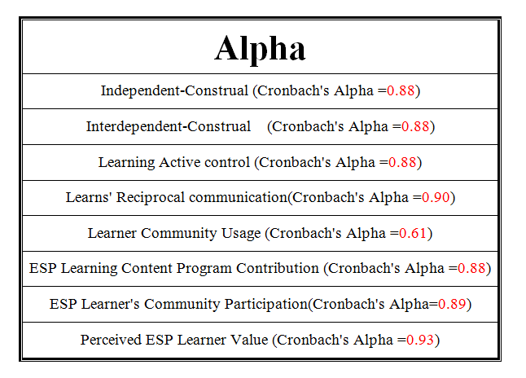
Table2

Slide 23
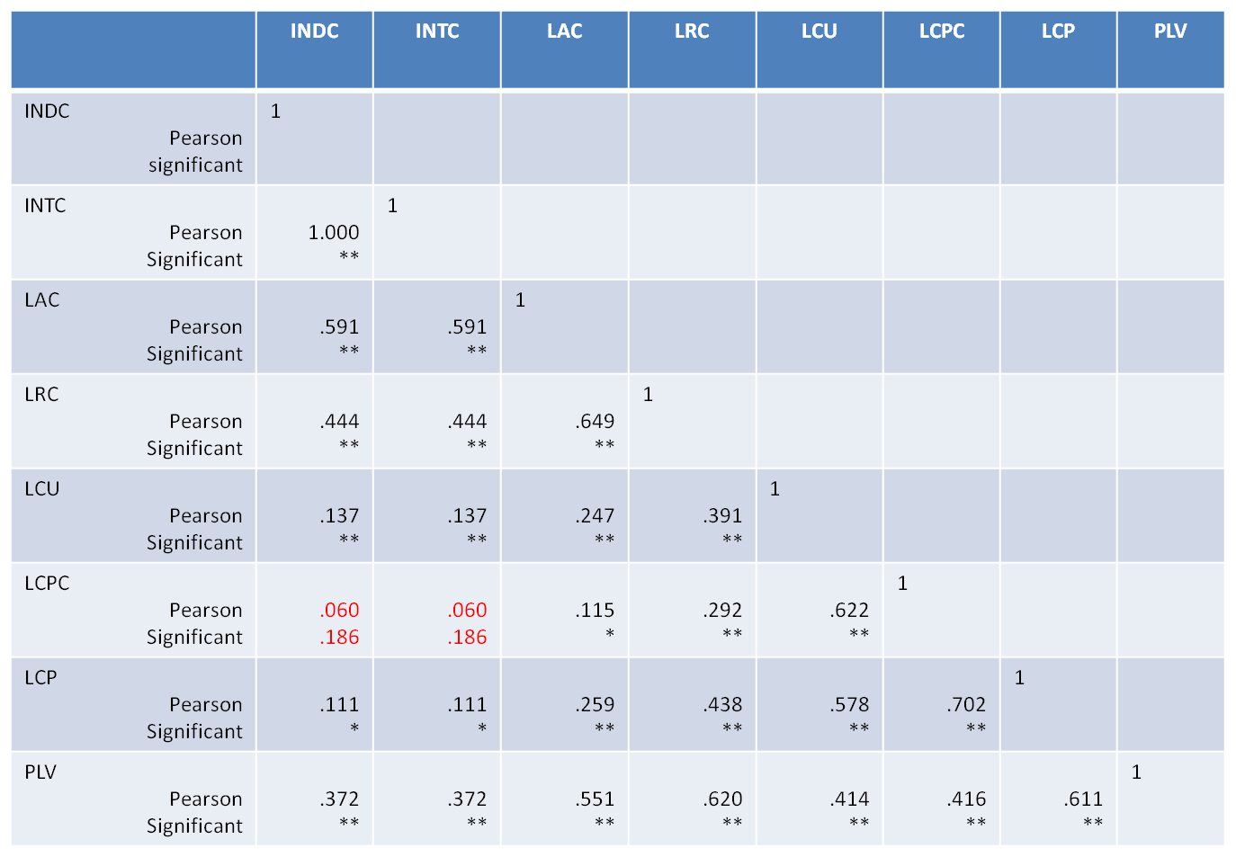
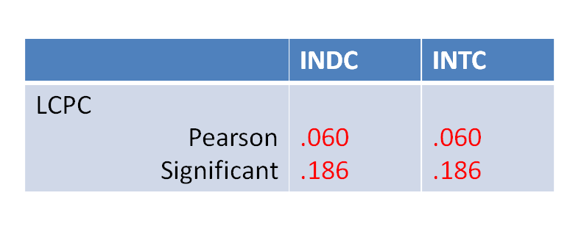
Table 3

Slide 24
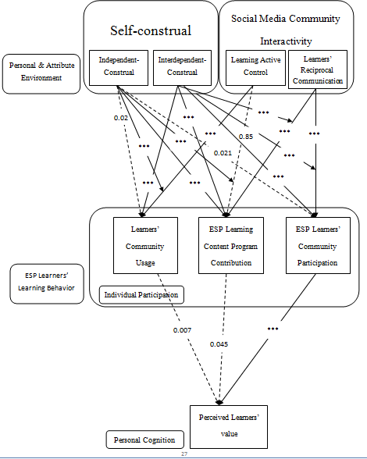
Hypotheses testing
Tenable
Untenable

Slide 25
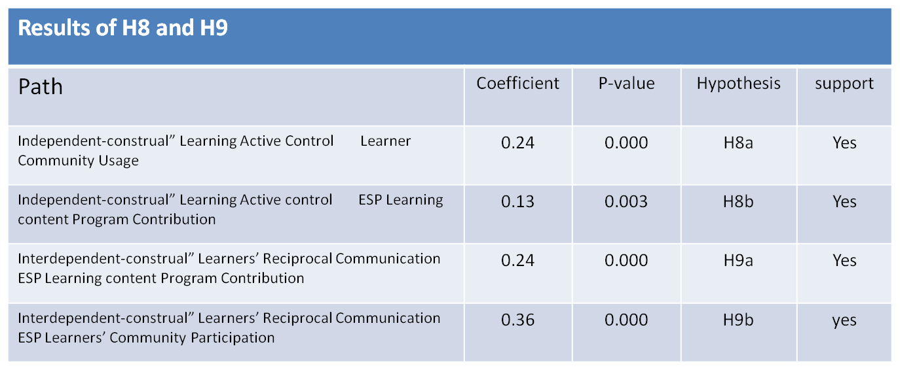
Table4

Slide 26
Discussion and Suggestion

Slide 27
Discussion
Most of our hypotheses are tenable expect two hypotheses and three extensions.
Extensions A and C of hypothesis 1
The Extension B of hypothesis 3
Hypotheses 5 and 6

Slide 28
Suggestion
This research project is focused on maritime English as its ESP content.
The reason may influence the results:
1. The scope of the study
2. The category of ESP
3. Cultural difference
Hope future study can integrate students of Western countries into subjects to increase the diversity of the data.

